Slide 1

Welcome
(LOCAL) EDUCATION ASSOCIATION
THANK YOU FOR ALL THAT YOU DO!

Slide 2






WE ARE YOUR PROFESSIONAL ORGANIZATION!
  Instant connections in and throughout the district, state and national levels.
  Professional development, training and mentoring opportunities.
  Advocate for public school students and protect your investment in your career.

Slide 3
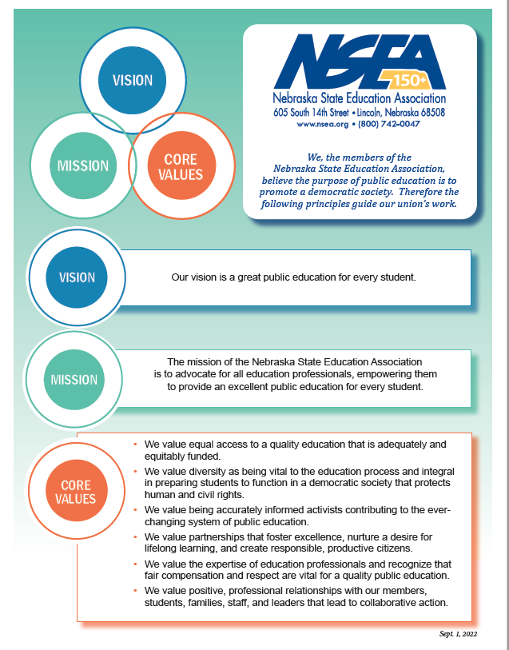
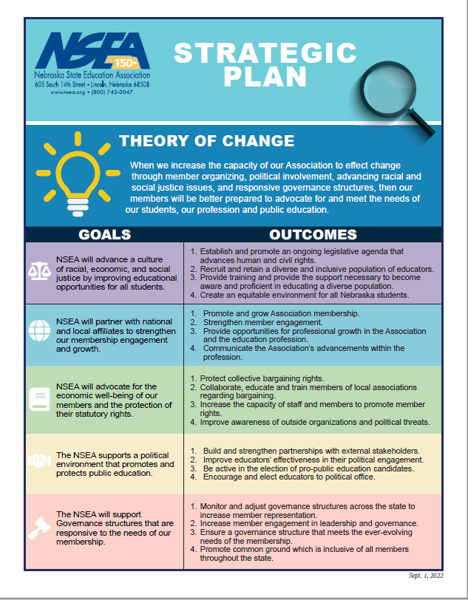
NSEA Strategic Plan

Slide 4
Local, District, State and National
Leadership Working for Members
The NSEA is 100 percent member-driven and member-led.
Members decide the direction of the organization, which issues to work on and who they want to represent them.
Members elect their local association representatives.
Members choose a state president, officers and Board of Directors who listen to the needs of our members across the state.
Members can choose many opportunities for leadership and involvement.
Members can contact NSEA President with any questions or concerns. jenni.benson@nsea.org

Slide 5
What NSEA does for you:
18 Organizational Specialists across Nebraska who serve every public school in the state. This allows someone to be nearby to assist you when you need help.
Your NSEA building is located right across the street from the state capitol, allowing us easy access to lobby on behalf of public education.
Assists with bargaining by helping with comp studies, tactics, gaining (and keeping!) recognition as the bargaining agent for EBEA, and helping you to get the best settlement you can.
Access to NEA Member Benefits and savings.
Liability insurance - Protection for your job!

Slide 6
Introductions – Local Officers
President -
Vice President –
Secretary –
Treasurer –
Head Negotiators -

Slide 7
Building Representatives

Slide 8

Professional Development
All learning options: https://www.nsea.org/webinars
Only Online courses: https://www.nsea.org/NSEAOnline

Slide 9
Children’s Fund
Do you have a student who needs a coat, shoes, eyeglasses, etc.?
Call 1-800-742-0047 or visit
https://www.nsea.org/childrensfund

Slide 10
NEA Member Benefits
NEA Member Benefits can help you save!
  Travel
  Hotels
  Air Fare
  Cruises
  Car Buying
  Visit neamb.com to learn more.

Slide 11
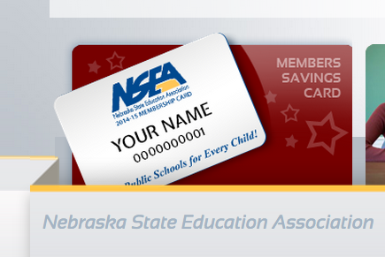
Benefits (cont’d)
NEA Click & Save - your membership card gives you a LOT of discounts
  Hotels, airfare, cruises, resorts
  Car rentals
  Restaurants
  Retail stores
  Electronics
  And more...

Slide 12
Benefits (cont’d)
DISCOUNT ON BUYING A NEW CAR!
“I’ve been able to save us $1,500 to 2,000 on each vehicle we’ve purchased over the past 6 years! It’s pretty easy!” - Jennifer Towle- Blair EA Local President
  Tax preparation
  Extended auto warranties
  Cell phone service discount - 18% with Verizon
  Magazines
  Flowers & gifts
  Wholesale club memberships

Slide 13
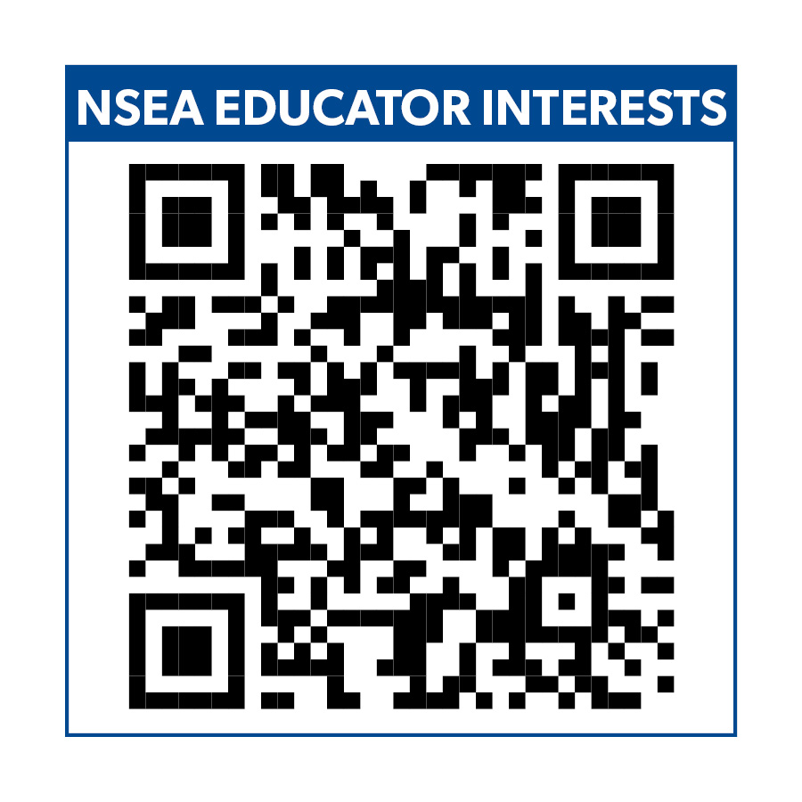
Educator Interest Card
Scan the QR code and complete the card to be entered into a drawing for some prizes.
By completing this card, you also provide us with feedback as we plan our professional development for the year. We want to offer things that our members are interested in!

Slide 14
Dues
Local Dues- $
State- $
National - $

Slide 15
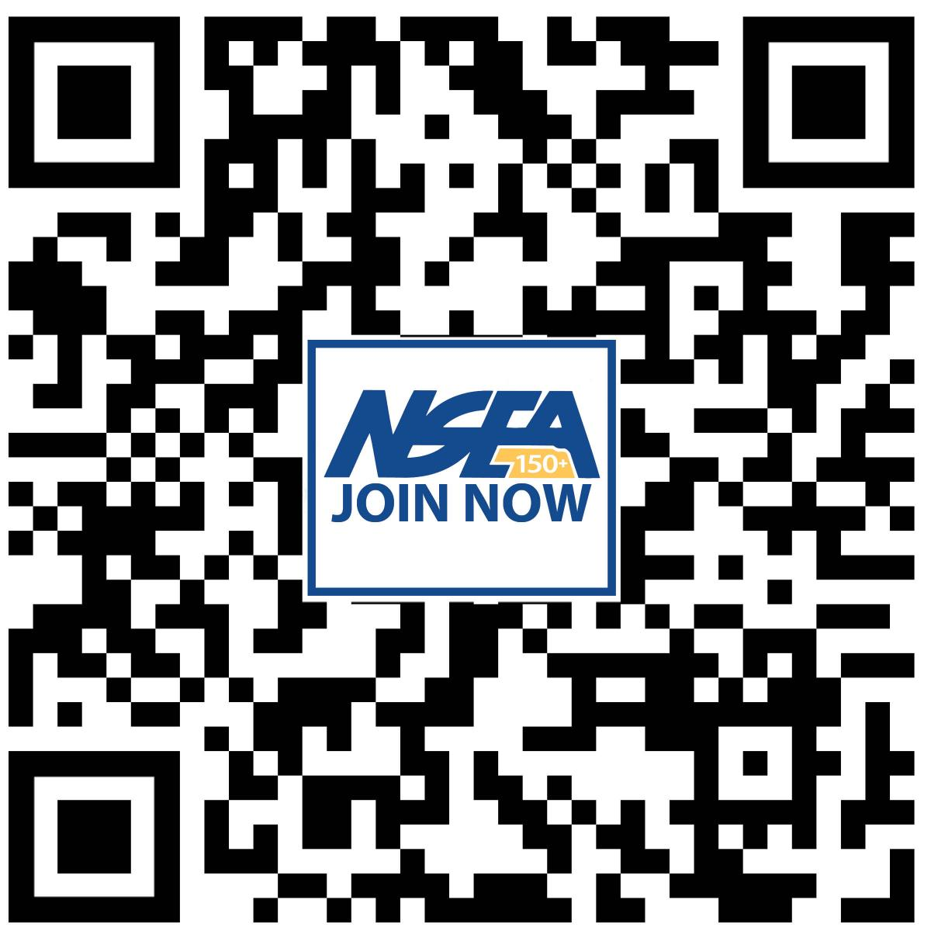
Join Now
Scan this code with your phone, or go to nsea.org/JoinNow
To scan a QR code, open your phone's camera, point it at the image above, and tap the link that pops up.

Slide 16
Contact Us
(YOUR)- Organizational Specialist

Slide 17

Thank you for your time! Questions?

